Slide 1

About Burp suit
Key Features
Flowchart
Process

Slide 2
About Burp suit:
Burp Suite is one of the best tools used to conduct web application penetration testing. It is a go between between your browser and website you are checking out, allowing you to see and make changes to everything that is being sent or received. It is really great for catching things like broken authentication, insecure inputs or hidden flaws.
Burp Suite is comprised of a set of tools that act together and it is convenient for both beginner and advanced testers.
Standards

Slide 3
Key Features
• Proxy Tool:
Intercepts traffic between your browser and the target site so you can inspect or manipulate it.
• Scanner (Pro version):
Automatically scans sites for vulnerabilities like XSS, SQLi, etc.
• Repeater:
Enables you to manually manipulate and resend requests to see how the server will react.
• Intruder:
Used for automatic attacks like brute force or fuzzing inputs.
• Decoder & Comparer:
Helps you inspect encoded data and compare request/response data.

Slide 4
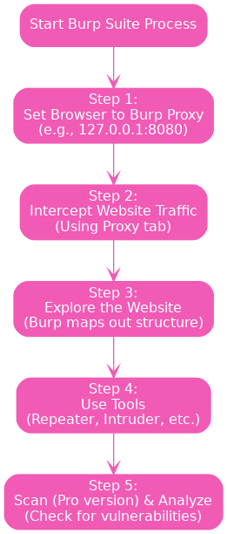
Flowchart

Slide 5
Process
Step 1: Set Up Your Browser • Make your browser use the Burp Suite proxy (usually 127.0.0.1:8080). Burp will then be able to intercept and listen to the traffic.
Step 2: Intercept Requests • With Burp running, go to the target website. Burp will intercept requests and responses, which you can view in the Proxy tab.
Step 3: Explore the Site • Click the site. Burp will graph the site topology and intercept traffic.
Step 4: Use Tools like Repeater and Intruder • Repeater: Select a request and manually modify it to attempt different inputs.
• Intruder: Execute attacks like brute force or fuzzing automatically.
Click on the model to interact

Slide 6
2. Relation between Earth, Sun, and Moon
Step 5: Scan for Vulnerabilities (Pro)
• If you have Pro, you can run an automated scan to determine security vulnerabilities.
Step 6: Analyze the Results
• Scan the output for vulnerabilities or anything out of the ordinary. You can also export the results for a report.
Example Use Case:
You open a login page in your browser, Burp intercepts the request. You send that request to Repeater, try different passwords and see how the site responds. This tells you if the site is vulnerable to brute force or weak authentication.

